Slide 1
Muhammad Musa
Week # 05
Bootstrap

Slide 2
Div
<div>---</div>
The Div is the most usable tag in web development because it helps us to separate out data in the web page and we can create a particular section for particular data or function in the web pages.
We use classes in div.

Slide 3
Class
E.g <div class=“col-lg-12”>
The class is an attribute which specifies one or more class names for an HTML element.
A class can be called by using a “.”.
Like if a class name is abc, it can be called as .abc

Slide 4
Container-fluid
<div class"container-fluid">
The container-fluid class provides a full-width container which spans the entire width of the viewport.

Slide 5
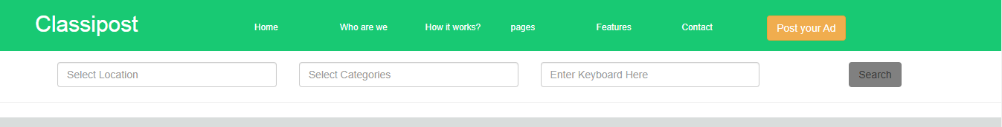
Row
<div class="row">
The row provides the columns a place to live, ideally having columns that add up to 12.
Row 1
Row 2

Slide 6
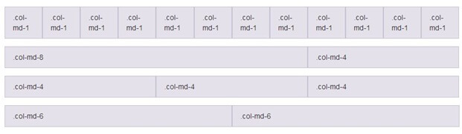
Col-lg-12
<div class="col-lg-12>
Column classes indicate the number of columns you'd like to use out of the possible 12 per row.

Slide 7
Colors
We use colors attributes/classes to change color of labels, textboxes, buttons etc.
In our examples we will use it to change background as well as text color of paragraphs.
In buttons, It changes the color of whole button not the color of text in button.

Slide 8

Primary
<p class="text-primary">.text-primary</p>
It is used to change color of text to blue.
It might work differently when used in buttons.

Slide 9

Secondary
<p class="text-secondary">.text-secondary</p>
It is used to change color of text to grey.
It might work differently when used in buttons.

Slide 10

Success
<p class="text-success">.text-success</p>
It is used to change color of text to green.
It might work differently when used in buttons.

Slide 11

Danger
<p class="text-danger">.text-danger</p>
It is used to change color of text to red. It might work differently when used in buttons.

Slide 12

Warning
<p class="text-warning">.text-warning</p>
It is used to change color of text to yellow.
It might work differently when used in buttons.

Slide 13

Info
<p class="text-info">.text-info</p>
It is used to change color of text to blue.
It might work differently when used in buttons.

Slide 14


Light/white
<p class="text-light">.text-</p>
It is used to change color of text to white. And its background is black.
It might work differently when used in buttons.

Slide 15
Code
<code> ------ </code>
The <code> tag is used to insert variables, fragments of program code, etc. into an HTML document.

Slide 16
KBD(keyboard)
<kbd>--- </kbd>
The <kbd> tag defines a keyboard input.

Slide 17
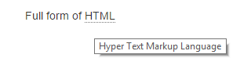
Abbr(Abbreviation)
<abbr title="world health organization">WHO</abbr>
The HTML <abbr> title attribute is used to specify the extra information about an element.

Slide 18

Class=jumbotron
<div class="jumbotron"> ------ </div>
A jumbotron indicates a big box for calling extra attention to some special content or information.

Slide 19
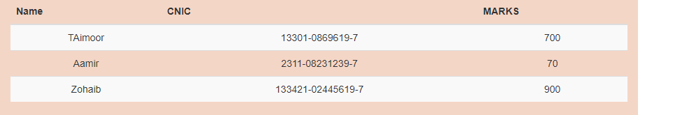
Table-striped
<table class="table table-striped"> ----- </table>
Use table-striped to add zebra-striping to any table row within the <tbody>.

Slide 20
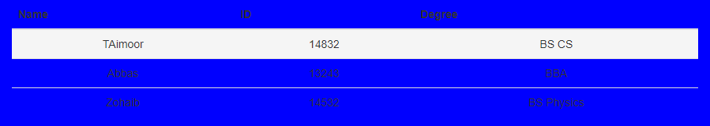
Table hover
<table class="table table-hover"> ------ </table>
Add table-hover to enable a hover state on table rows within a <tbody>.

Slide 21

Thumbnail
class="img-thumbnail“
img-thumbnail to give an image a rounded 1px border appearance.

Slide 22
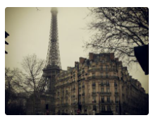
Rounded Corners
class="img-rounded”
The rounded class adds rounded corners to an image.

Slide 23

img-Circle
class="img-circle"
The rounded-circle class shapes the image to a circle.

Slide 24
Form control
class="form-control“
Form controls automatically receive some global styling with Bootstrap: All textual <input> , <textarea> , and <select> elements with class . form-control have a width of 100%.

Slide 25
Form group
<div class="form-group”>
form-group class is the easiest way to add some structure to forms. It provides a flexible class that encourages proper grouping of labels, controls, optional help text, and form validation messaging.-group.

Slide 26

Placeholder
placeholder="Name"
The placeholder attribute specifies a short hint that describes the expected value of an input field (e.g. a sample value or a short description of the expected format).

Slide 27

Navigation bar
<nav class="navbar navbar-default">
A navigation bar is a navigation header that is placed at the top of the page.

Slide 28
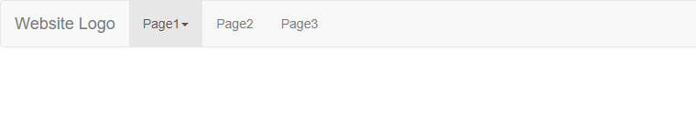
Navbar-header
<div class="navbar-header">
The navbar-header is mostly an architectural class for Bootstrap navbar.

Slide 29

Navbar brand
class="navbar-brand"
.navbar-brand for your company, product, or project name.

Slide 30
Navbar Menu
class="nav navbar-nav"
Navbar Menu is the element that wraps the navbar links.

Slide 31

Dropdown toggles
class="dropdown-toggles"
The dropdown-toggle class adds the outline: 0; on :focus to the button, so when you click on the button it will not have the surrounding blue border of the "active" element.

Slide 32

Caret
class="caret">
Use carets to indicate dropdown functionality and direction. To get this functionality use the class caret with a <span> element.

Slide 33
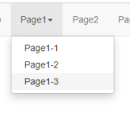
Drop down menu
class="dropdown-menu“
A dropdown menu is a toggleable menu that allows the user to choose one value from a predefined list: Dropdown Example.

Slide 34
Slider/Carousel
Three main parts;
1)Images.
2)Controls.
3)Indicators.

Slide 35
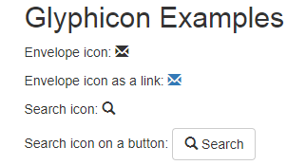
Glyphicon
The Glyphicons are a set of symbols and icons to understand more effectively and easily in web projects. The Glyphicons are used for some texts, forms, buttons, navigation, and etc.

Slide 36
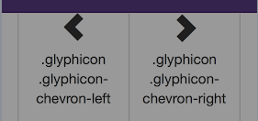
Chevron
class="glyphicon glyphicon-left” or class="glyphicon glyphicon-right”
It is used to create arrows that direct you either left or right.

Slide 37
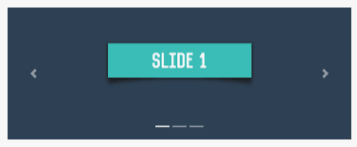
myCarousel
<div id=“myCarousel”>
Helps to function and controls properly.

Slide 38
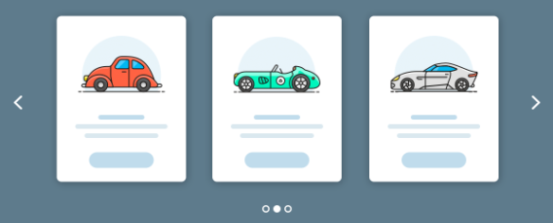
Carousel Slide
Class=“carousel slide”
Carousel defines the slides.
It specifies that this div contains a carousel.
These slides perform animations.
Which makes the items slide when showing a new item.

Slide 39
Data Ride
Data-ride=“carousel”
This attribute tells bootstrap to begin animating the carousel immediately when the page loads.

Slide 40
Indicators part
1)Carousel indicator
2)Data-Target
3)Data-slide-to

Slide 41

Carousel-Indicator
Class=“carousel-indicators”
The indicator are specified in an ordered list with class.

Slide 42
Data Target
data-target=“ ”
This attribute points to the id of the carousel.

Slide 43
Data slide to
data-slide-to=“”
This attribute specifies which slide to go to, when clicking on the specific dot.

Slide 44
Wrappers for slides
a) Carousel inner.
b) Item.

Slide 45
Carousel Inner
Class=“carousel-inner”
The slides are specified in a div with class.

Slide 46
Item
Class=“item”
The content of each slide is defined in a div with class.(this can be text or images).

Slide 47
Active
class="item active"
The .active class needs to be added to one of the slides. Otherwise, the carousel will not be visible.

Slide 48

Pagination
Class=“pagination”
If we have a website with lots of pages, we may wish to add some sort of pagination to each page.

Slide 49

Tabs
<ul class="nav nav-tab">
Tabs are used to separate content into different panes where each pane is viewable one at a time.
Tabs are used to separate content into different panes where each pane is viewable one at a time.

Slide 50

Pills
<ul class="nav nav-pills">
Pills are components placed in pages to speed up browsing.

Slide 51
Muhammad Musa
Week # 06
Javascript

Slide 52
Data Types
A data type is a classification of data which tells the compiler or interpreter how the programmer intends to use the data. Most programming languages support various types of data, including integer, real/float, double, character or string, and Boolean.

Slide 53
Int or Integer
Int a=1;
Int, short for "integer," is a fundamental variable type built into the compiler and used to define numeric variables holding whole numbers.

Slide 54
Float
A float is a data type composed of a number that is not an integer, because it includes a fraction represented in decimal format.

Slide 55
Double
The double is a fundamental data type built into the compiler and used to define numeric variables holding numbers with decimal points.
Typically it is used for large numbers upto 15 digits.

Slide 56
Character
A character is a display unit of information equivalent to one alphabetic letter or symbol. This relies on the general definition of a character as a single unit of written speech. Character can also be abbreviated as "chr" or "char."

Slide 57
String
a string is traditionally a sequence of characters, either as a literal constant or as some kind of variable

Slide 58
Boolean
A boolean or bool is a data type with two possible values: true or false.

Slide 59
Variables
There are 3 ways to declare a JavaScript variable:
var
let
Const
In programming, just like in algebra, we use variables (like price1) to hold values.
In programming, just like in algebra, we use variables in expressions (total = price1 + price2).

Slide 60
var
var a;
JavaScript uses reserved keyword var to declare a variable. A variable must have a unique name

Slide 61
Let
Let a;
let allows you to declare variables that are limited to the scope of a block statement, or expression on which it is used, unlike the var keyword

Slide 62
Constant
Const a;
Once a constant is initialized, we cannot change its value. Simply, a constant is a type of variable whose value cannot be changed

Slide 63
Onclick()
onclick='document.getElementById("d").innerHTML= "Good Morning"‘
Using onclick in this specific code changes the text of that particular tag with id=“d” to “Good Morning.
The text will change only when the tag with id=“d’ is clicked.

Slide 64
innerHTML
document.getElementById("d").innerHTML= "Good Morning"
The innerHTML property is used to get or set the HTML content of an element node. The innerHTML property is part of the Document Object Model (DOM) that allows Javascript code to manipulate a website being displayed.

Slide 65
getElementByID()
document.getElementById("d").innerHTML= "Good Morning"
The Document method getElementById() returns an Element object representing the element whose id property matches the specified string.

Slide 66
If Statement
if (condition) { // block of code to be executed if the condition is true }
Use the if statement to specify a block of JavaScript code to be executed if a condition is true.

Slide 67
Example of if condition
if(5<8) {
document.getElementById("one").innerHTML="Good Morning";
}

Slide 68
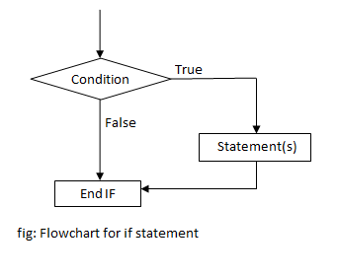
If condition flow chart

Slide 69
If else statement
if (condition) { // block of code to be executed if the condition is true } else { // block of code to be executed if the condition is false }
Use the else statement to specify a block of code to be executed if the condition is false.

Slide 70
Example of if else condition
var a=40;
var b=10;
var answer= a/b;
if(answer>b) {
document.getElementById("one").innerHTML="Good ";
}
else {
document.getElementById("one").innerHTML="Good Bye";
}

Slide 71
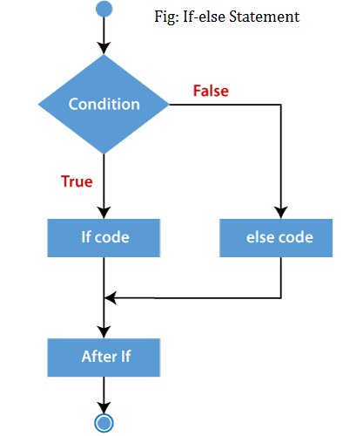
If else condition flow chart

Slide 72
If else if
if (condition1) { // block of code to be executed if condition1 is true } else if (condition2) { // block of code to be executed if the condition1 is false and condition2 is true } else { // block of code to be executed if the condition1 is false and condition2 is false }
Use the else if statement to specify a new condition if the first condition is false.

Slide 73
Example of if else-if
var b=10;
var f=9;
var c=b+f
console.log(c);
document.getElementById("a").innerHTML=c;
if(c>f) {
document.getElementById("one").innerHTML="C is greater than f ";
}
else if(c<f) {
document.getElementById("one").innerHTML="C is smaller than f";
}
else if(c==f) {
document.getElementById("one").innerHTML="C is equal to F";
}
else {
document.getElementById("one").innerHTML="Good Bye";
}

Slide 74
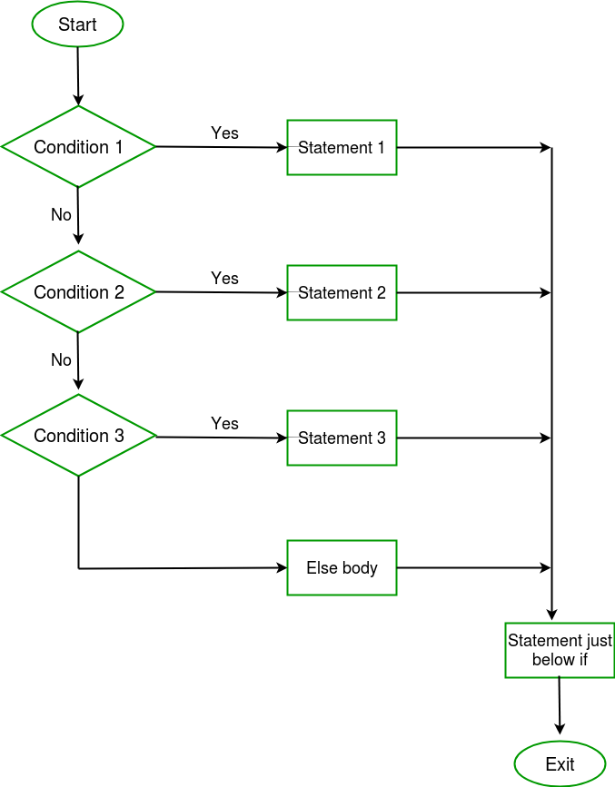
If else-if condition flow chart

Slide 75
Switch Statement
switch(expression) { case x: // code block break; case y: // code block break; default: // code block }
Use the switch statement to select one of many code blocks to be executed.

Slide 76
Working of Switch
This is how it works:
The switch expression is evaluated once.
The value of the expression is compared with the values of each case.
If there is a match, the associated block of code is executed.
If there is no match, the default code block is executed.
The default keyword specifies the code to run if there is no case match

Slide 77
Break
When JavaScript reaches a break keyword, it breaks out of the switch block.
This will stop the execution inside the switch block.
It is not necessary to break the last case in a switch block. The block breaks (ends) there anyway.

Slide 78
For loop
for ( initialization condition ; termination condition ; increment condition )
{
statement ( s ) ;
}
For loops are commonly used to count a certain number of iterations to repeat a statement. Use a break statement to exit the loop before the condition expression evaluates to false.

Slide 79
For loop cont…
We see that a 'for statement' consists of three parts.
In initialization condition, we initialize some variable while in continuation condition,
we set a condition for the continuation of the loop.
In third part, we increment the value of the variable for which the termination condition is set.

Slide 80
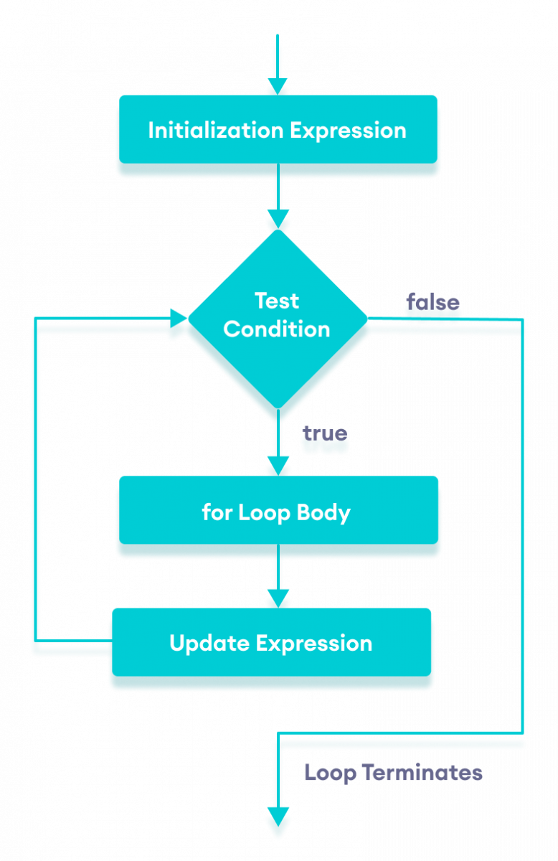

Slide 81
While loop
while (condition)
{
statements;
}
In while loop, the condition is tested first and the statements in the body are executed only when this condition is true. If the condition is false, then the control goes directly to the statement after the closed brace of the while loop.

Slide 82
Do-while loop
do
{
statements ;
}
while ( condition ) ;
The do-while loop statement creates a loop that executes a block of code until a test condition evaluates to false

Slide 83
Increment operator
counter ++ ;
same as
counter = counter + 1;

Slide 84
Decrement operator
counter -- ;
same as
counter = counter - 1

Slide 85
+=
counter += 3 ;
same as
counter = counter + 3 ;

Slide 86
-=
counter -= 5 ;
same as
counter = counter – 5 ;

Slide 87
*=
x*=2
x = x * 2

Slide 88
/=
x /= 2
x = x / 2

Slide 89
%=
x %= 2 ;
same as
x = x % 2 ;

